Slide 1
Maturity Model for Microsoft 365 Practitioners
Advanced Content Management – Retention & Compliance
August 2021
⭐Guest star⭐ Joanne Klein
Marc Anderson, Sympraxis Consulting | @sympmarc
Simon Doy, iThink 365 | @simondoy
Simon Hudson, Novia Consulting | @simonjhudson
Initiative started by Sadie Van Buren as SharePoint Maturity Model in 2010
Notes:
EMILY

Slide 2


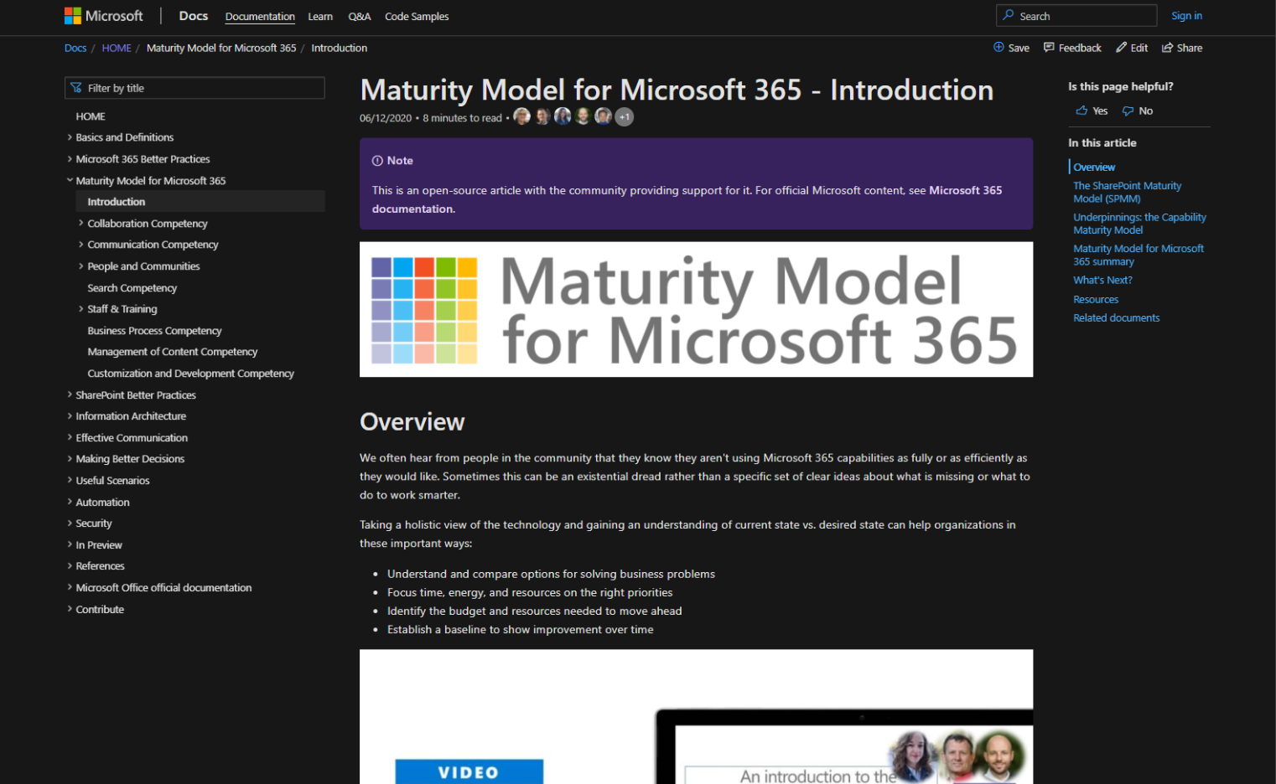
v
Agenda
Practitioner & Maturity Model overview
Artifacts and Updates
Purpose
How to get more involved
Shout-out & Picture Time (Together Mode!)
Discussion: Advanced Content Management – Retention & Compliance
Notes:
EMILY

Slide 3

The approach and articles on Microsoft Docs
Artefacts
Improve organization through use of technology
Benchmark company and department
Select appropriate approach
Develop an organizational business and technical roadmap based on:
What's possible
What's desired
Organization's culture and drivers
Lead and support strategic planning, with senior management
Align implementation needs and objectives
Discuss use of the platform with IT – not just technology
Socialization tool
PURPOSE
Published Competencies
Supporting Articles
Business Process
Running a MM4M365 workshop
Principles of…
Collaboration
Practitioner meeting recordings
Search
Communication
Communication
Open Competencies
Management of Content
How to elevate…
In progress
People & Communities
Infrastructure
Collaboration
Search
To do
Communication
Security…
Staff & Training
People & Communities
Customization & Development
Data & Analytics
Staff & Training
Notes:
SIMON H
New resources: Running a workshop, plus associated workbooks

Slide 4
MM4M365 provides benchmarks to measure your organization
Maturity Level | Description | Keywords
Level 500 Optimizing | Deliberate and systematic process improvement/optimization Focus is on continually improving process performance Addressing statistical common causes of process variation and iterative process improvement | Optimal, systematic, statistical, improvement-focus, automated, assured, proactive
Level 400 Predictable | Actively managed in accordance with agreed processes and has tracked metrics Effective achievement can be evidenced across a range of operational conditions Process has been tested and refined Process users demonstrate competence | Productive, interactive, responsive, enhanced, effective, adaptable, quality
Level 300 Defined | Defined and standardized Signed off, managed process Limited validation of effectiveness, doesn’t include edge cases Process users demonstrate familiarity | Documented, policy-driven, planned, controlled, stable
Level 200 Managed | Key processes defined but not standardized, uniformly or strongly applied Some ability to demonstrate consistent outcomes Limited buy-in from staff and management Widespread inconsistency and resistance | Routine, legacy, fire-fighting, variable, personally managed
Level 100 Initial | Default, starting/exploratory state People driven processes, lacking documentation and discipline Many ways of doing the same thing (with variable results) Characterised by inefficient legacy approaches and pockets of unmanaged innovation | Ad hoc, reactive, uncontrolled, chaotic, unstable, not designed
Source: https://docs.microsoft.com/en-us/microsoft-365/community/microsoft365-maturity-model--intro
Notes:
SIMON H

Slide 5
MM4M365 – Intention at each level
Maturity Level | Description | Intent
Level 500 Optimizing | Deliberate and systematic process improvement/optimization Focus is on continually improving process performance Addressing statistical common causes of process variation and iterative process improvement | “We want to ensure all the key processes are always effective and resilient, while designing the same into anything new we do”
Level 400 Predictable | Actively managed in accordance with agreed processes and has tracked metrics Effective achievement can be evidenced across a range of operational conditions Process has been tested and refined Process users demonstrate competence | “Let’s make things even better by measuring, analyzing and taking actions to improve based on that“
Level 300 Defined | Defined and standardized Signed off, managed process Limited validation of effectiveness, doesn’t include edge cases Process users demonstrate familiarity | “We have defined our processes, policies and procedures, everyone seems to be doing the right thing; let’s keep doing that”
Level 200 Managed | Key processes defined but not standardized, uniformly or strongly applied Some ability to demonstrate consistent outcomes Limited buy-in from staff and management Widespread inconsistency and resistance | “We should ensure everyone knows what they should be doing”
Level 100 Initial | Default, starting/exploratory state People driven processes, lacking documentation and discipline Many ways of doing the same thing (with variable results) Characterised by inefficient legacy approaches and pockets of unmanaged innovation | “Let’s keep putting the fires out and keep the lights on!”
Notes:
SIMON H

Slide 6
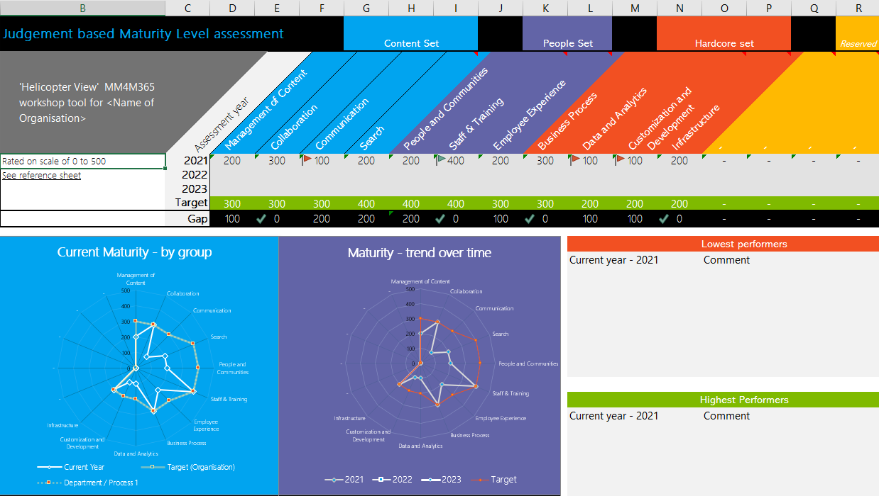
Purpose
Discussion-based monthly meeting
Highlights of new assets
Understanding the competencies
Mapping technology to maturity levels and competencies
Running a workshop
Measuring maturity
Sharing anecdotes and success stories
Feedback on the maturity model
Safe space to hone your pitch, test your thoughts, or decide how to promote your use of the Maturity Model
OVERVIEW
Practitioners for
Maturity Model
for Microsoft 365
Get Involved
https://aka.ms/sharing-is-caring
Present case study (at MM4M365 Practitioners or other speaking opportunities)
Contribute on GitHub
Provide feedback, insights, tools, and artifacts
Socialize
content
Run a MM4M365 workshop
https://docs.microsoft.com/en-us/microsoft-365/community/microsoft365-maturity-model--run-workshop
Recordings
http://mmvideos.m365.ms/
Notes:
EMILY

Slide 7
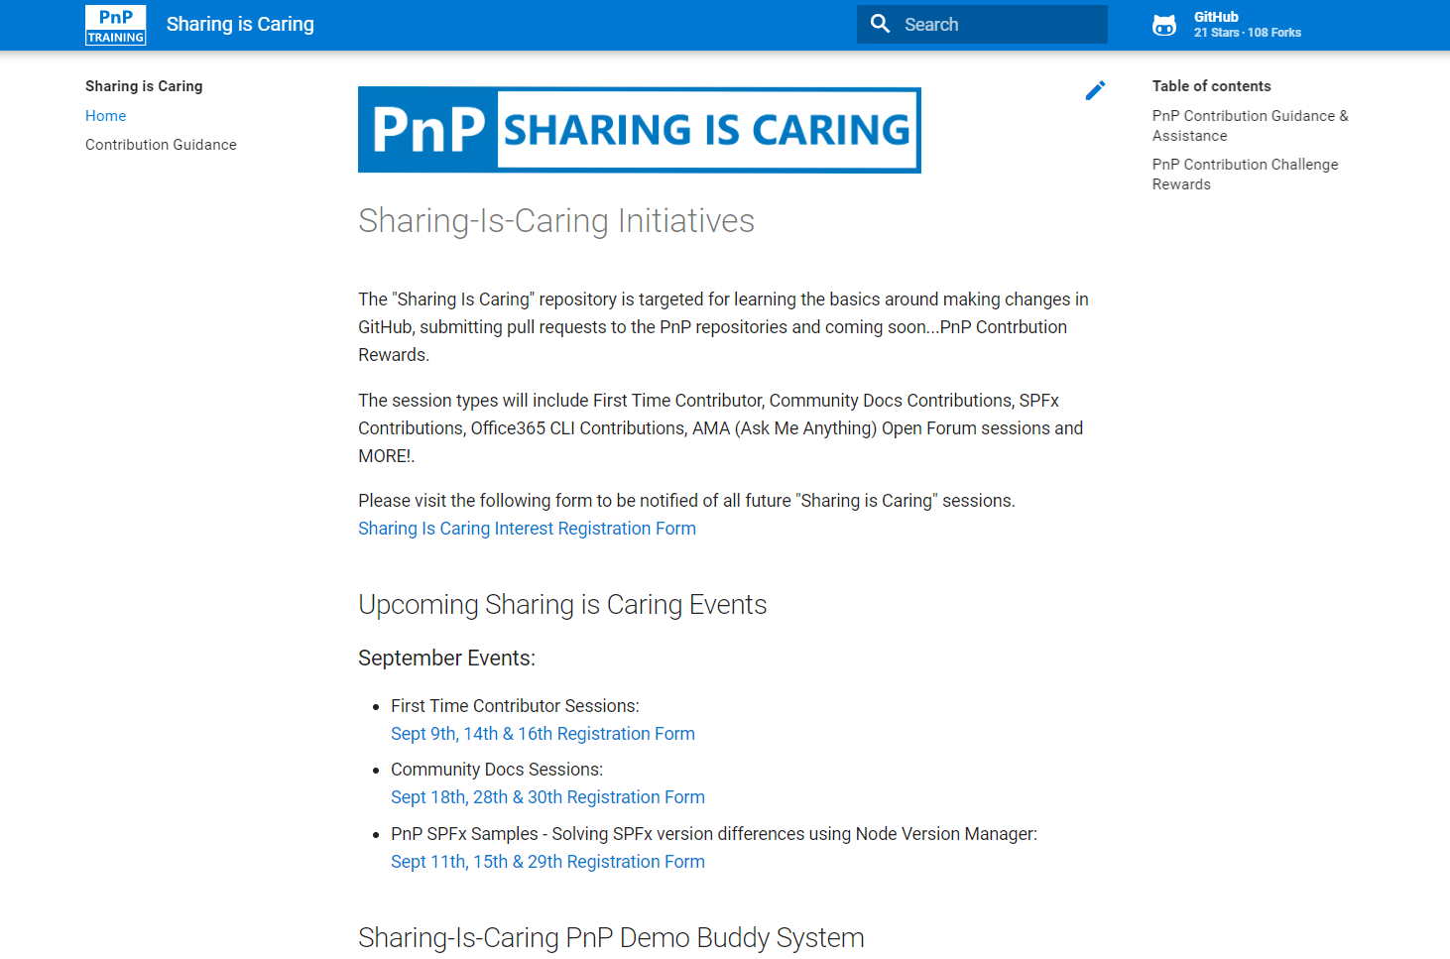

GUIDANCE
Get started on the open-source and community work?
Community Docs Sessions
Monday, 23rd August, 1pm PST
First Time Contributor Sessions
Tuesday, 31st August, 2pm PST
Thank you, July attendees
Aaron Blair
Abdush Miah
Alistair Pugin
Anna Sanfilippo
Archer, Carlene
Balk, Tim L
Bob Morris
Burns, Andrew
Christine Green
Dale Pilarczyk
Daniel S. Peterson
David Warner
David Warner II
Edmund Davis
Gray, David
Hadrien-Nessim Socard
James Cragle
Jasmine Hoegh
Jason Lambiris
Joe Gasper
John Holliday
Joni Jackson
Julie Peck
Kathleen Boilek
Manickam S
Manjunath Siddappa
Melissa Declercq - Savaco
Michael Blumenthal
Nicole J Fleming
Nicolle Abrahams
Patrick Tucker
Puttaswamy, Manjunath
Rajesh Puri
René Modery
Rivas, Ralph
Ron Jones
Ross Allan
Sabrina Faragoza
Seb Matthews
Sharon Weaver
Simon Doy
Simon Hudson
Simon Thompson
Sue McGuire
Sue-Adrie Jefthas
Tammie Brown
Tavakoli, Amin
Teufel, Frank
Torres, Annie
Xavier Buillit
Yoder,Lance
Next MM4M365 call
September 21st at 7:00am PST
Topic: TBA
Third Tuesday of every month
https://aka.ms/sharing-is-caring
https://aka.ms/sharing-is-caring

Slide 8
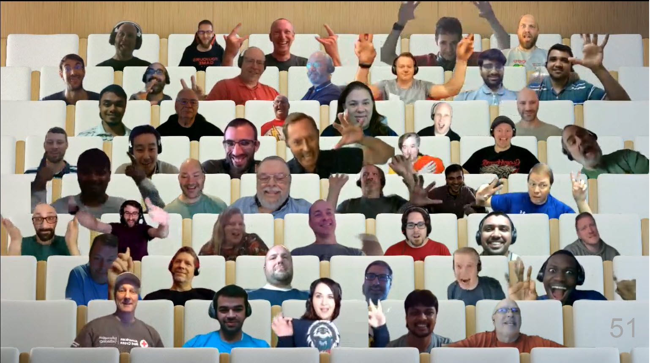

PnP Picture Time!
Please turn your video on
we’ll grab a Together Mode pic with everyone who wants to be seen to be here.
We are together in this as a community!
Notes:
EMILY

Slide 9

DISCUSSION
Advanced Content Management
Retention & Compliance
PROTOCOL
Visually emote and support Share reactions while others are speaking
Come off mute and share your thoughts
Share your camera (don’t be shy)
Raise your hand to say your piece (and put it down again!)

Slide 10
Terminology
Compliance
The process of being able to prove that the business meets required standards and measures as defined by the business and/or law.
Information Governance
Information governance (IG) is a term used to describe how information is used in a compliant way. It covers system and process management, records management, data quality, data protection and the controls needed to ensure information sharing is secure, confidential and responsive to organisational needs.
Retention
Retention is a process that enables a business to be compliant through a process of retaining and deleting content within an organization to configured timescales.
Records management
ISO 15489-1:2016 defines records as "information created, received, and maintained as evidence and as an asset by an organization or person, in pursuit of legal obligations or in the transaction of business".
Records management is the process of preserving records to act as evidence of an event.
Notes:
Understand the difference between IG and Records Management

Slide 11
Compliance
Commonly related to:
Core Operations
Financial
HR
Legal
Clinical
Intellectual Property
Health and Safety
Retention generally one of:
Business books, inventories, balance sheets, annual financial statements, management reports, consolidated financial statements, group management reports, work instructions
Business letters received
Copies of business letters sent
Accounting documents
What does compliance mean in your organization?
Legal or regulatory requirements
What are they REALLY? Don't trust the organizational myths.
Business and Strategic needs (organizational)
Department policies and needs
Team-based conventions
Notes:
Holistically how we govern data across the organization
CSO vs records management people
Sensitivity labels

Slide 12
Retention
Sequencing and Process
Building retention ideas
Be sure to include key stakeholders
Legal
Regulatory
Operational
IT
Compliance
Risk
etc.
Contrast between retention and discovery impacts
Can't do retention or compliance until you understand your content well enough for it to make sense
Retention can't precede other content management practices
Information lifecycle
Identify what you have
Decide what needs to happen with it
Implement specific retention policies
Retention policy intersection with content sub-corpuses
Notes:
Joanne - defining retention policies
GDPR
CTTA

Slide 13
Retention plans/regulations
Vary by characteristics like:
Sovereignty (e.g., UK vs US)
Type of content
Statutory vs. organizational requirements
Type of Document | Statutory Minimum Retention Period | Recommended Period of Retention
Statutory Returns, Records and Registers
Annual Return (copy) | N/A | Permanently
Return of Allotments (copy) | N/A | Permanently
Directors' Service Contracts | 6 years after cessation | 6 years after cessation
Register of Directors and Secretaries (original) | Permanently | Permanently
Register of Directors' interests in Shares and Debentures | Permanently | Permanently
Register of interests in voting shares | Permanently | Permanently
Register of Charges | Permanently | Permanently
Register of Documents sealed (if applicable) | N/A | Permanently
Unpaid dividend records | N/A | 12 years after dividend declared
Dividend and interest mandate forms ceased to be valid | N/A | 3 years from when the instruction
Notification of address change by member | N/A | 2 years after notification
Incorporated Documents
Certificate of Incorporation and Certificates on Change of Name | N/A | Permanently
Certificate to Commence Business (Public Company) | N/A | Permanently
Memorandum and Articles of Association (original and updated copies) | Permanently | Permanently
Printed copies of resolutions submitted to Companies House | Permanently | Permanently
Download Retention Periods Guide (UK)
Share Registration Documents
Register of Members | N/A | Permanently
Register of Debentures and Loan Stock Holders | N/A | Permanently / 7 years after redemption of stock
Letters and forms applying for Shares, Debentures etc. | N/A | 12 years from issue, with a permanent microfilmed record
Renounceable Letter of Allotment and Acceptances | N/A | Originals for 12 years from renunciation, with a permanent microfilmed record
Renounced Share Certificates | N/A | Originals for 12 years from renunciation, with a permanent microfilmed record
Contracts for purchase of own shares by Company | N/A | Period of retention 10 years from date of contract
Share & Stock Transfer forms and Letter of Request with permanent microfilmed record | N/A | 12 years after date of transfer
Requests for designating or redesign ting accounts with permanent microfilmed record | N/A | 12 years after request
Cancelled Share/Stock Certificate | N/A | 1 year from date of cancellation
Stop Notice and other Court Orders | N/A | Permanently
Letters of indemnity for lost Certificates | N/A | Permanently
Powers of Attorney | N/A | Permanently
Dividend and interest payment lists | N/A | Until audit of the dividend payment is complete
Paid dividend and interest warrants | N/A | 6 years after date of payment

Slide 14
What about the Crawl-Walk-Run approach?
It's a "better together" story
Layer/integrate crawl-walk-run with the M365 Maturity Model
Each Maturity Model level could have a crawl-walk-run within it
What complicates compliance?
Maturity of the Data Governance/Data Protection program in your org
Industry, geography, and size all play a factor in the compliance controls required
Do you have established, modernized "Compliance" teams?
Have your regulations been modernized from a paper-based world?
Proliferation of digital communication channels housing "records"
Do your SharePoint Content Management teams understand compliance?

Slide 15
Level 100 - Initial
No clear understanding (or manifestation) of regulatory or statutory requirements
Staff don’t understand their data and how it relates to compliance obligations
No version history used
No process for lifecycle management is in place
No functional protection for documents
Permissions used as compliance
Retention = save everything
No definitive documents
Risks
Lost content
Content deleted that should be retained
Too much content
content retained that should be deleted
No auditability
can’t prove what was done or what was ‘true’
Use of incorrect information
Breach
data loss, external intrusion, quality failure, safety incident etc.
Compliance comments/ideas:
This level is all about realizing you have a problem
Tech tools available: Data Classification, Audit logs, Compliance Manager, Compliance Score
Crawl-walk-run hasn't even started
Notes:
What is there to stop a breach?
What happens when there is a breach?
Version history may be enabled, but not understood or used (still creating versions via file names: e.g. “safety_assessment_v1.docx”
STOP RECORDING

Slide 16
Level 200 - Managed
Understanding of regulatory or statutory requirements limited to certain roles
Staff don’t understand their data and how it relates to compliance obligations, but often carry out basic retention & compliance tasks
Version history enabled but poorly exploited
Need for lifecycle management is understood but not comprehensively applied
No functional protection for documents
Permissions, governance and protection applied sporadically
Document removal is ad hoc, periodic and inconsistent
Definitive documents identified, but duplicates/superseded version exist
Poor findability of important content
Poor adoption of compliance processes
managers are unnecessarily busy, stressed and frustrated by the lack of progress.
Risks
Lost content - Content deleted that should be retained
Too much content – content retained that should be deleted
Inefficient auditability – can’t always prove what was done or what was ‘true’; conflicting information to be resolved
Poor decisions made due to incomplete or out of date information
Poor productivity - time lost seeking important information and records, recreation of existing content.
Unnecessarily busy, stressed and frustrated staff.
Breach
Compliance comments/ideas:
Knowing your data well is critical – great place to start
Understand capabilities of product and how you might map them to your obligations (regulatory, legal, business)
Tech tools: Data Classification, Sensitive Info Types, Compliance Manager, Retention Policies (for ROT)
Start building compliance guidance to end-users... yes, this matters!
Notes:
Staff are told to do Retention etc.

Slide 17
Level 300 - Defined
Definitive documents managed and protected, but staff occasionally bypass these or cannot find them at the point of need.
Compliance processes are generally document and broadly adopted
File plan and policies identify records and their management, including retention needs based on business, regulatory and statutory requirements
Important content has processes for lifecycle tracking, with periodic clean up and disposal. Retention mechanisms are attempted. Many documents lack appropriate protection or governance, despite an understanding of the need for compliance and other controls.
Staff broadly understand their data and why it needs to be managed to comply with regulations
There is some effort to ensure important content is retained and there are occasional efforts to cleanse old documents; this may result in loss of important information due to absence of robust controls. Staff can deviate from many processes, though this is actively discouraged.
Version control is in general use and version-duplicates are largely absent (though other sources of duplicates do occur)
Role-based access, governance and protection is in use, though not comprehensively
Naming conventions are in place for many classes of content, these are often enforced using technical or process measures.
Risks
Critical risks are assessed and written up in a risk log and action plans
Retention relies on periodic intervention and user knowledge, errors occur.
Lack of a Removal policy results in over-retention, clutter and need for conflict resolution
Auditability not iron clad, resulting in non-critical findings and auditor concerns
Compliance activities over-applied to some processes
Staff are reactive to compliance needs and changes
Breaches are rare but resolution is stressful and resource intensive
Compliance comments/ideas:
Acknowledgement of the myriad of digital comms channels where "records" can be found
Mapping retention schedule to M365 File Plan (identify gaps and approach)
Tech tools: Sensitivity labels (default), Records Management, File Plan, Retention Policies, Retention Labels
Maintain compliance guidance to end-users
Notes:
Staff are trained in Compliance, IG & risk and the need for retention etc

Slide 18
Level 400 - Predictable
Content Lifecycle Management is in active use in all regulated or quality assured processes and elsewhere that has impacts on the business.
Most documents are tagged with sensitivity, status and retention information or reside in a location where this is enforced.
Information Governance and compliance activities extend to all types of content, including List items Media files, Email and messaging, web pages and news items.
Retained content regularly reviewed to ensure they remain useful/relevant.
Compliance by design within repositories
include templates, identification metadata, lifecycle and disposition markers, status and other policies by default.
Active removal of content in accordance with policies
Staff responsible for ongoing "decluttering" and organization of collaboration and personal content.
Controls and monitoring are in place and used to review these activities, though typically without automation or strong enforcement.
Duplication of content is actively avoided
Periodic checks to identify unnecessary duplicates.
Good understanding of version control and version history, and these are appropriately used.
Role-based access, governance and protection is well designed, documented and consistently implemented.
Document Retention mechanisms are in place for all important classes of content
Reviewed annually to ensure policies and technical controls are effective and appropriate.
Governance board reviews new needs and oversees decisions on retention, disposition and destruction of content.
There are standard content categories, and these are widely used to label, group and tag content,
There is some automation of tagging and classification.
Risks are understood, managed and processes are in place to both prevent and to deal with incidents and breaches
Notes:
Staff are trained, assessed and maintained re: IG, risk, which includes retention

Slide 19
Level 400 – Predictable continued
Compliance comments/ideas:
"Compliance by Design" is where ML, AI comes into the picture...
Trainable Classifiers
SharePoint Syntex (still for targeted business processes)
Automation
Site Provisioning process should be tightly coupled with Compliance controls:
SharePoint team and Compliance teams need to be in lock-step on this
Microsoft Information Protection | auto-labeling on Client-side and Service-side
Microsoft Information Governance | auto-labeling, default labeling, SharePoint Syntex
Notes:
Staff are trained, assessed and maintained re: IG, risk, which includes retention

Slide 20
Level 500 - Optimizing
Content Lifecycle Management operates at most levels of the organization
Optimized, tracked and reviewed for effectiveness
Actively drives quality, productivity and risk reduction
Content tagging for classification, access, sensitivity, status and retention is widely automated as are relationships between content.
Retention policies are actively managed and tested.
Unmanaged documents are the exception.
Document Retention is applied to almost all content, including items in lists, emails other non-file types of content.
Policies and technical controls are actively updated in response to changing needs and regulatory and business landscape.
Default removal policies and notifications drive broad compliance and clutter avoidance. Removal of content is largely automated.
Metrics describe the entire content position across multiple dimensions including status, usage, value and more.
External organizations are actively assisted in achieving robust levels of maturity. Email attachments are rare.
Proactive deduplication is in place. Potential duplicates are identified at the point of content creation.
Role-based access, governance and protection are deeply embedded in processes and are designed with minimal "friction" for the task or process.
Content categorization is largely automated; existing content is analyzed on an ongoing basis to apply tagging and labelling in order to ensure that new context, topics, classes and policies are applied dynamically as these emerge in the business.
Risks are understood at all levels. Active and automated processes are in place that proactively prevent incidents. Incident recovery is regularly tested, and the lessons learned are actively fed back into the process.

Slide 21
Level 500 – Optimizing continued
Compliance comments/ideas:
Automation is critical to success at scale
Tooling implemented for the many aspects of maintaining compliance:
Content compliance: File and Email retention and protection
Container compliance: Site/Team/Group retention and protection
Communication Compliance (Email, Teams Chats, Teams Messages, Skype, Yammer messages)
Dependencies:
Mature, modern, fully-staffed compliance teams
Ongoing monitoring and auditing for net new content and comms channels that may house sensitive data and "records"
Deep understanding of regulatory, legal, and business obligations.... they change!
Notes:
Staff are trained, assessed and maintained re: IG, risk, which includes retention

Slide 22
Scenarios
The company needs to manage its staff and process policies in order to remain complaint and ensure staff only work to the latest version of each.
The sales team need to issue new quotations and access previously issued versions, similar quotations for other clients and different quotations to the same client. These need to have consistent layouts and information.
Company vision and values need to be updated and communicated across the company, with previous versions removed.
Financial and HR documents need to be retained for legal purposes.
Project teams need to be able to access all documents related to a project and understand their status.
Information Governance need to ensure that all sensitive information is identified and not shared externally.
Marketing wants to ensure all internal and external documents use the new company logo, colors and mission statement.
Staff need to know where to store the product specification information, QA reports and analysis data for a new product. They also need to update the new product pipeline overview for the sales and marketing teams.

Slide 23
Resources
Maturity Model for Microsoft 365 – Introduction https://symp.info/M365MM
Flowchart to determine when an item will be retained or permanently deleted https://symp.info/RetentionFlowchart

Slide 24
Future topics
Search
Business process
Communication
Collaboration

Slide 25
Thank you
Follow us on Twitter
@M365Maturity | @M365CommDocs
Take the Maturity Model Self-Assessment
https://symp.info/MM4M365-SelfAssessment
Fill out the Maturity Model Survey
https://symp.info/MM4M365Survey
Discussions in Github
https://symp.info/MM4M365Discussion
Next MM4M365 monthly call: Sept 21st at 10am ET / 7am PT
Third Tuesday of every month
https://aka.ms/sharing-is-caring

Slide 26


aka.ms/m365pnp

